Slide 1


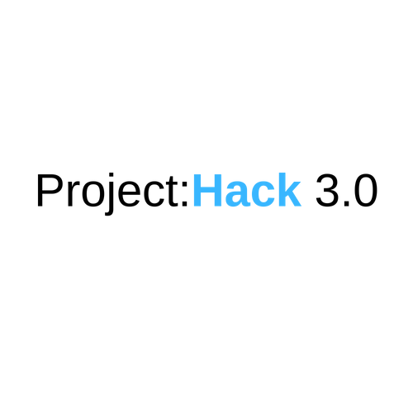
An Introduction to Machine Learning
Dr James Smith
Chief Technology Officer
www.projectingsuccess.co.uk
Page 1 | 26/06/2019 | | www.projectingsuccess.co.uk

Slide 2
Let’s get setup.
If you want to code with me – EVERYTHING you need is in my slides so download them from here:
Add tiny url to dropbox link
Page 2 | 26/06/2019 | www.projectingsuccess.co.uk | Strictly Commercial in Confidence

Slide 3

Let’s get setup.
Sign in
(or create - but who doesn’t have a Google account right?!)
Page 3 | 26/06/2019 | www.projectingsuccess.co.uk | Strictly Commercial in Confidence

Slide 4
Overview
Let’s get setup
Who am I?
Which Integrated Dev Environment (IDE)?
How to make progress on your own!
Why Python?
Machine learning with Iris data
Page 4 | 26/06/2019 | www.projectingsuccess.co.uk | Strictly Commercial in Confidence

Slide 5
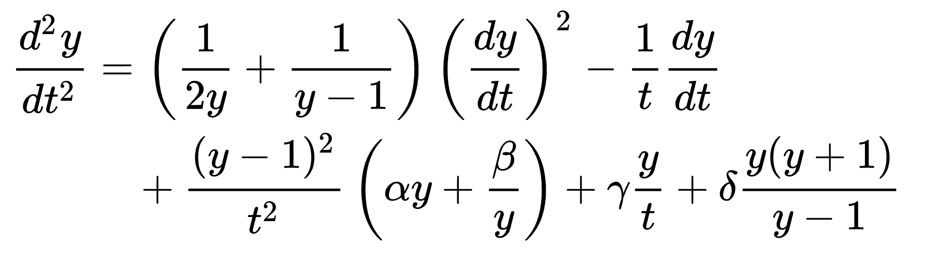


Who am I?
Completed my PhD in applied Mathematics in 2015 – Painlevé equations and Orthogonal Polynomials
Lectured mathematics at the University of Kent
Joined Projecting Success in 2017
Interests:
Mathematics
Machine Learning
Python

Slide 6
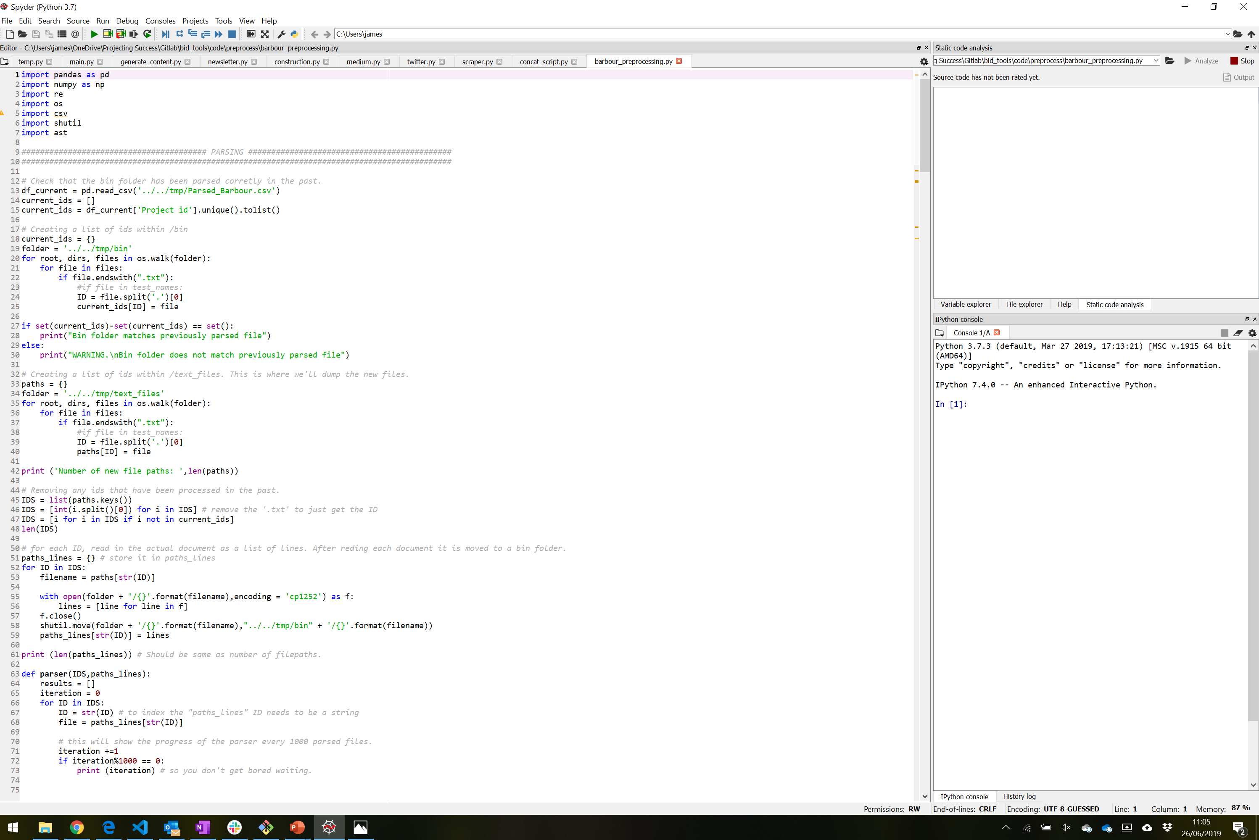
Which Integrated Dev Environment (IDE)?
Page 6 | 26/06/2019 | www.projectingsuccess.co.uk | Strictly Commercial in Confidence

Slide 7
Which Integrated Dev Environment (IDE)?
Save and reload code files If an IDE or editor won’t let you save your work and reopen everything later, in the same state it was in when you left, it’s not much of an IDE.
Run code from within the environment Similarly, if you have to drop out of the editor to run your Python code, then it’s not much more than a simple text editor.
Debugging support Being able to step through your code as it runs is a core feature of all IDEs and most good code editors.
Syntax highlighting Being able to quickly spot keywords, variables, and symbols in your code makes reading and understanding code much easier.
Automatic code formatting
Any editor or IDE worth it’s salt will recognize the colon at the end of a while or for statement and know the next line should be indented.
Page 7 | 26/06/2019 | www.projectingsuccess.co.uk | Strictly Commercial in Confidence

Slide 8


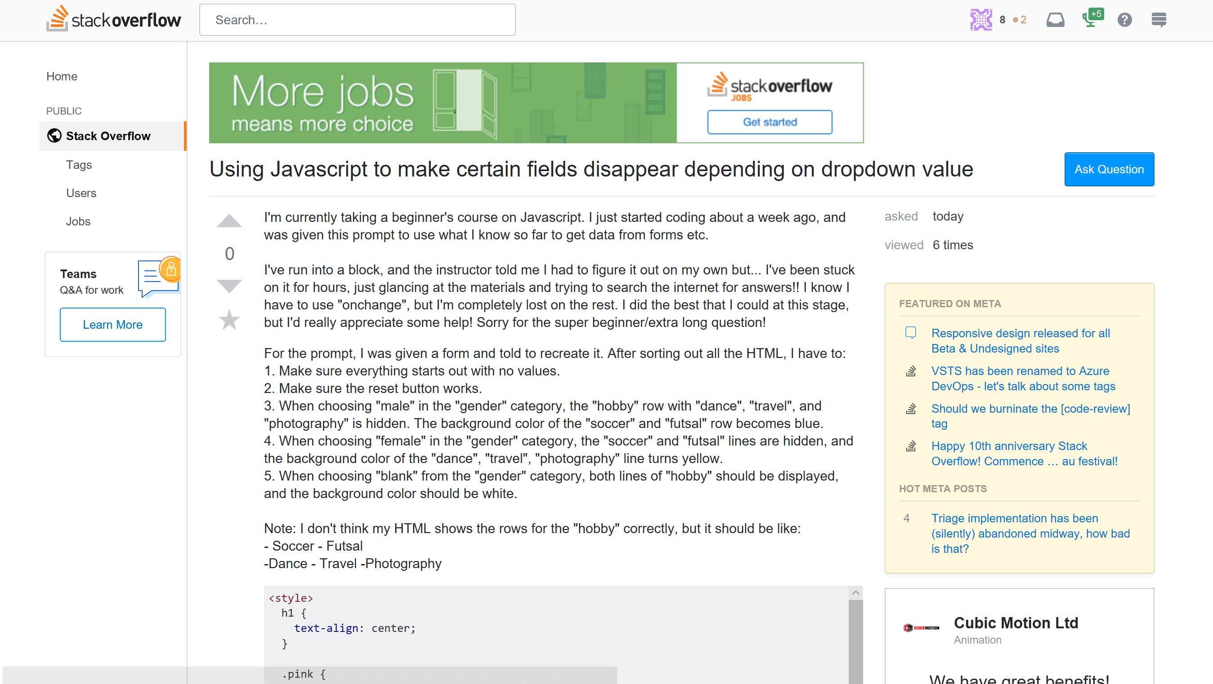
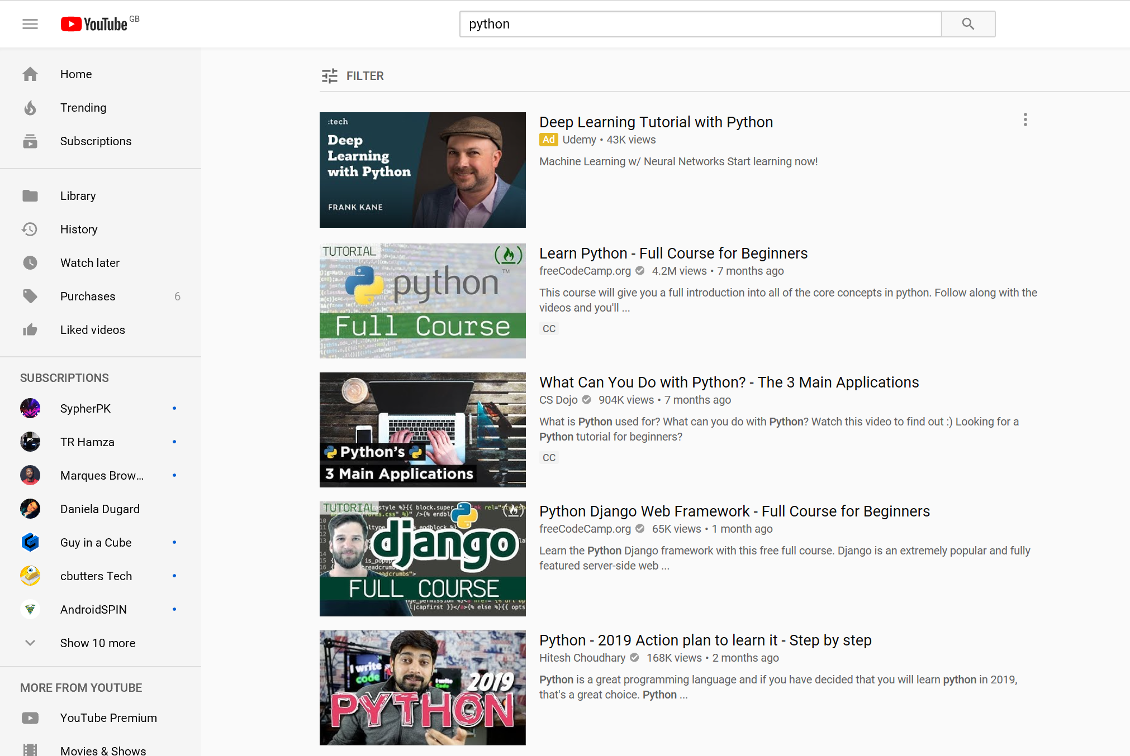
How to make progress on your own!
https://github.com
https://www.udemy.com
https://stackoverflow.com/
https://www.youtube.com/
Page 8 | 26/06/2019 | www.projectingsuccess.co.uk | Strictly Commercial in Confidence

Slide 9
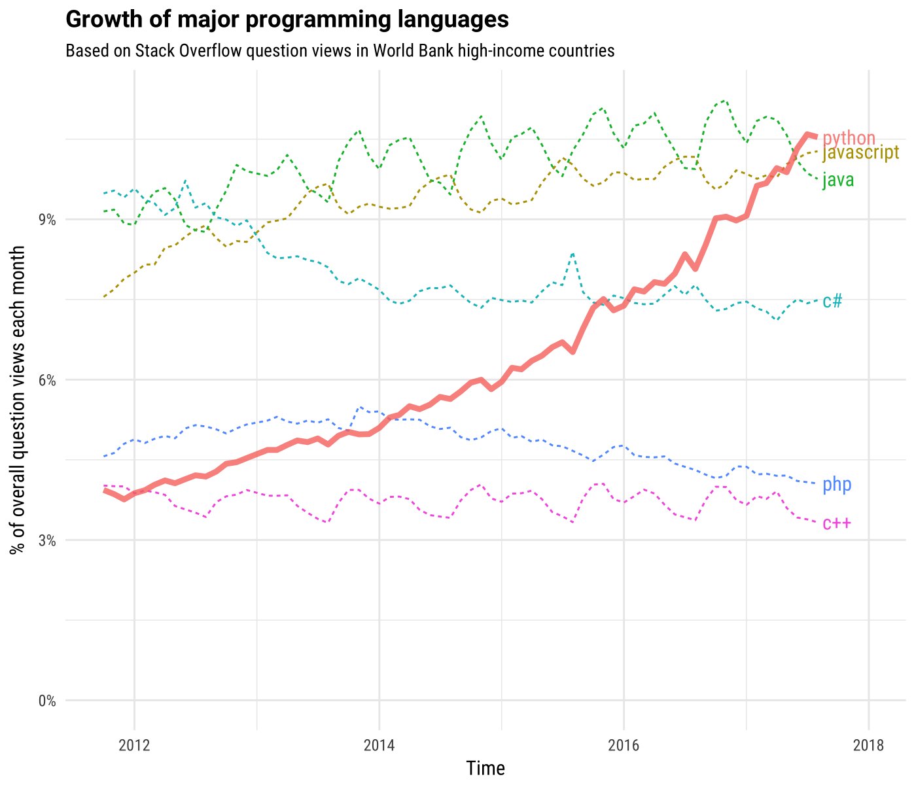
Why Python?
Page 9 | 26/06/2019 | www.projectingsuccess.co.uk | Strictly Commercial in Confidence

Slide 10
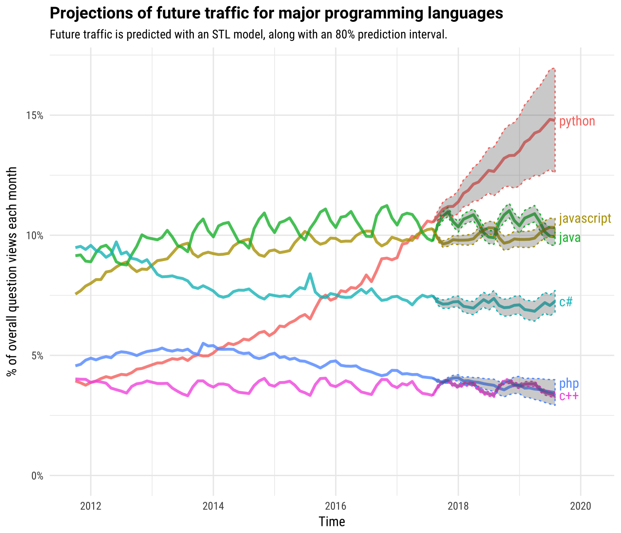
Why Python?
Page 10 | 26/06/2019 | www.projectingsuccess.co.uk | Strictly Commercial in Confidence

Slide 11



Machine learning with Iris data
30 minutes
Grab the IRIS_data
Open - Google Colab
“Copy” this GitHub url
Intro to Google Colab
Right click “copy link”
Page 11 | 26/06/2019 | www.projectingsuccess.co.uk | Strictly Commercial in Confidence

